Slide 1
Computer Networks
CS 430

Slide 2
Exam 1 Review

Slide 3
Objectives
Networking basics
Application layer protocols
Transport layer protocols

Slide 4
Exam Format
10 questions
Fill the blanks
Short problems
Packet analysis
Closed book

Slide 5
Topics
Throughput and delays
Protocols and layers
HTTP response codes
HTTP packet analysis
DNS record types
DNS packet analysis
Well-known application ports
UDP Header format
TCP Header format
TCP State diagram
Congestion control
Bitwise operations
Command line utilities
Wireshark

Slide 6
Commands
ipconfig
ping
nslookup
traceroute
netstat
ifconfig
tracert
route
ip
mtr
dig
arp

Slide 7
Delays
How long does it take a packet of 2000 bytes to propagate over a link of distance 500 km with the propagation speed of 2.5*10⁸ m/s and the transmission rate of 10 Mbps? Show your work.

Slide 8
Throughput
A truck drives from West Union to Decorah (25 miles) carrying a 100 of 1 TB drives. Assuming truck’s average speed of 50 mph, calculate the throughput of this data transfer.

Slide 9
Binary Arithmetic
Given an 2-byte number (e.g. 2018), extract the left and the right bytes.
Given an n-byte number, convert it to a list of bytes.

Slide 10
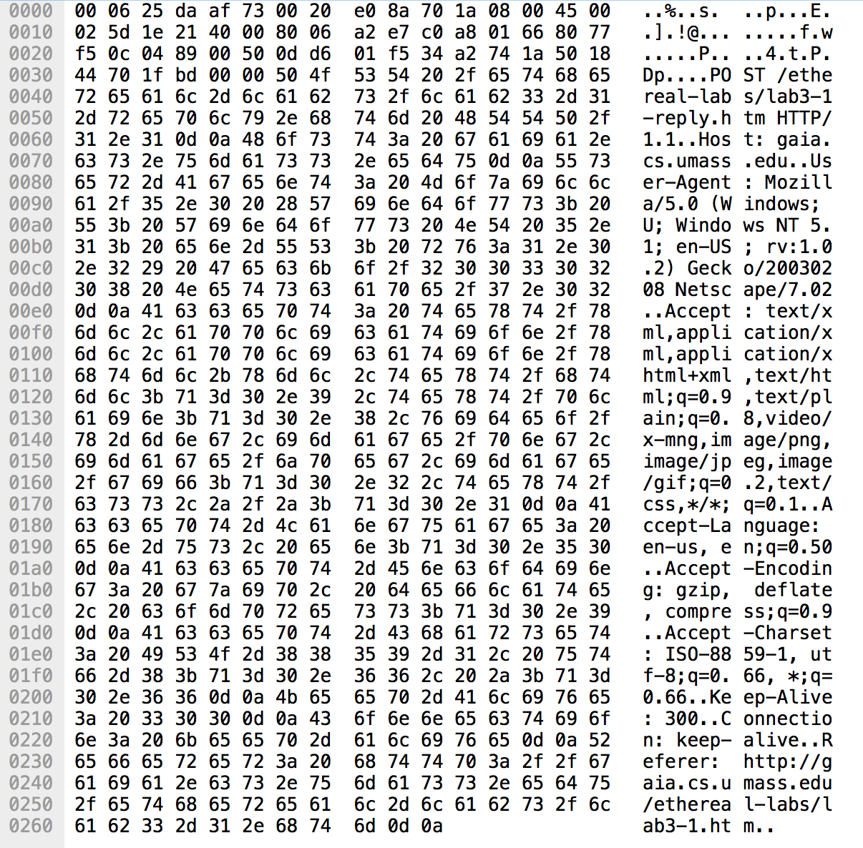
HTTP
What HTTP method is the client using? Look for HTTP messages containing either GET or POST method.
POST

Slide 11
HTTP
What is the IP address and the port number used by the client? Is the client downloading or uploading data? (Hint: look for the amount of data that that flows in either direction)
192.168.1.102 is a client uploading (POST-ing) data to 128.119.245.12

Slide 12
HTTP Response Codes
2xx Success
3xx Redirect
4xx Client error
5xx Server error

Slide 13
DNS
Analyze the attached file (CS430_DNS.pcapng or CS430_DNS.zip). Write a display filter to show requests for AAAA type resolution only. How many such requests are there in the trace file? How many responses were received?
dns.qry.type==28
dns.aaaa
8 requests (0 DNS)
0 responses

Slide 14
DNS
Analyze the attached file (CS430_DNS.pcapng or CS430_DNS.zip). What IP addresses does www.paypal.com resolves to? What are the numbers of packets that provide this information?
dns.resp.name=="www.paypal.com"
23.13.82.234
23.196.228.157
Packets 9, 12, 42, 90, 113, and 125

Slide 15
DNS
Analyze the attached file (CS430_DNS.pcapng or CS430_DNS.zip). What is the largest DNS TTL value seen in that file? What is the number of a packet that contains that value?
dns.resp.ttl
Custom column dns.resp.ttl
DNS TTL 7196 in #3

Slide 16
DNS
Analyze the attached file (CS430_DNS.pcapng or CS430_DNS.zip). Which DNS response transaction ID contained the largest number of Answer RRs? What is the number of a packet that contains this information?
dns.resp.len
Custom column dns.resp.len
11 RRs in #98 (0x9ab9)

Slide 17
Common Port Numbers
FTP
HTTP
POP3, IMAP, SMTP
Telnet
SSH
HTTP(S)
DNS

Slide 18
Checksum
Calculate the sum and its 1s complement of the following 3 bytes:
01010011
01100110
01110100
Show your work.
 | 0 | 1 | 0 | 1 | 0 | 0 | 1 | 1
 | 0 | 1 | 1 | 0 | 0 | 1 | 1 | 0
 | 0 | 1 | 1 | 1 | 0 | 1 | 0 | 0
1 | 0 | 0 | 1 | 0 | 1 | 1 | 0 | 1
 | 0 | 0 | 1 | 0 | 1 | 1 | 1 | 0
 | 1 | 1 | 0 | 1 | 0 | 0 | 0 | 1

Slide 19
Exercises
What is one's complement sum of the following characters?
‘C’, ‘S’, ‘4’, ‘3’, ‘0’
ASCII Table

Slide 20
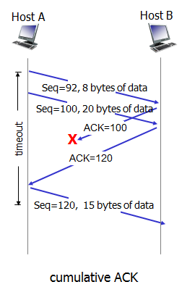
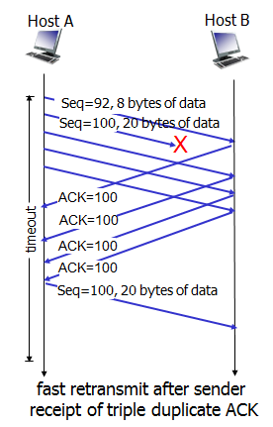
TCP Acknowledgements

Slide 21
TCP Exercise
What is the real sequence number in the SYNACK segment sent by the server (Hint: read TCP_Relative_Sequence_Numbers - The Wireshark Wiki to display real, not relative sequence numbers)?
Relative SEQ: 0
Relative ACK: 1
Real SEQ: 883061785
Real ACK: 232129013

Slide 22
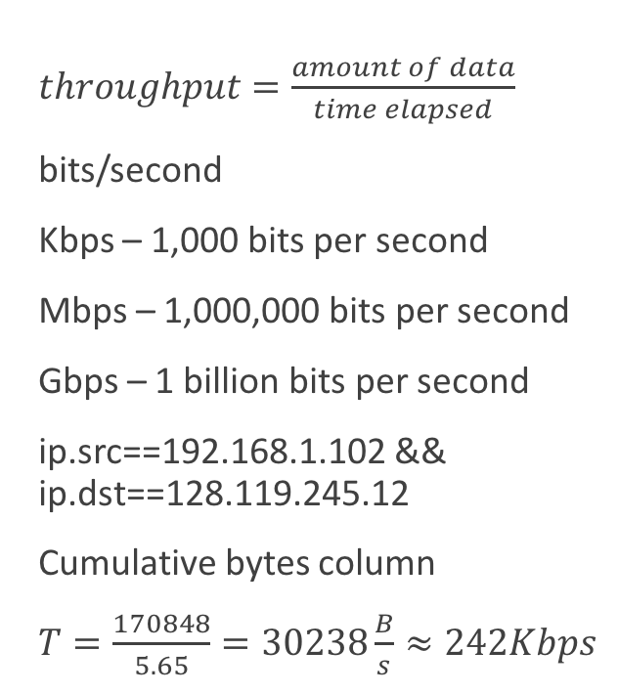
TCP Exercise
What is the throughput (bytes transferred per unit time) for the TCP connection? Explain how you calculated this value.
$throughput=\frac{amount of data}{time elapsed}$
bits/second
Kbps – 1,000 bits per second
Mbps – 1,000,000 bits per second
Gbps – 1 billion bits per second
ip.src==192.168.1.102 && ip.dst==128.119.245.12
Cumulative bytes column
$T=\frac{170848}{5.65}=30238\frac{B}{s}≈242Kbps$

Slide 23
TCP Exercise
What is the minimum amount of available buffer space advertised at the received for the entire trace? Does the lack of receiver buffer space ever throttle the sender?
Custom column
tcp.window_size

Slide 24
Exercises
Consider the following packet (part of a Telnet session). What are the expected sequence number and acknowledgment number in the response packet (sent from server to client)?

Slide 25
Thank You!

